Slide 1
Estimating Daily PM2.5 Concentration by Spatial Statistical Downscaling with INLA
Mar 13, 2024

Slide 2
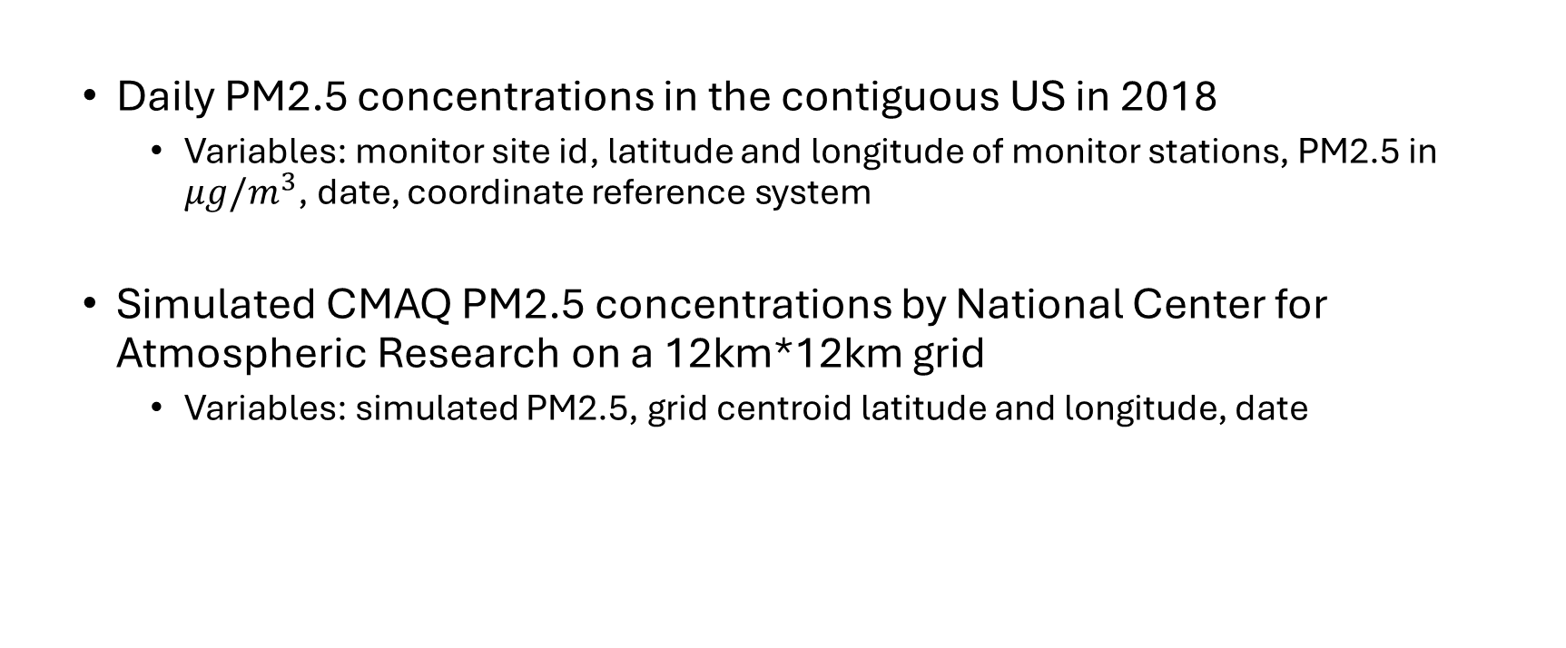
Data
Daily PM2.5 concentrations in the contiguous US in 2018
Variables: monitor site id, latitude and longitude of monitor stations, PM2.5 in $μg/m^{3}$, date, coordinate reference system
Simulated CMAQ PM2.5 concentrations by National Center for Atmospheric Research on a 12km*12km grid
Variables: simulated PM2.5, grid centroid latitude and longitude, date

Slide 3
Processing Steps
Match PM2.5 monitor to its closest CMAQ grid location using Euclidean distance.
Merge two datasets by date and location.
Project PM2.5 monitor locations in (latitude, longitude) to (km, km).
Divide the dataset into 52 1-week subsets according to dates of measurements.
Note: there were no PM2.5 measurements on 2018-12-31 in the source dataset.
Remove missing and negative PM2.5 measurements.
Note: 2.39% of rows were dropped.

Slide 4
Descriptive Table
Characteristic | Overall, N = 235,402 | Q1, N = 57,494 | Q2, N = 58,285 | Q3, N = 59,741 | Q4, N = 59,882
Daily PM2.5
Mean (SD) | 8.3 (7.3) | 8.0 (6.2) | 7.5 (4.1) | 9.6 (8.1) | 8.3 (9.3)
Range | 0.0, 411.7 | 0.0, 318.8 | 0.0, 167.8 | 0.0, 261.0 | 0.0, 411.7
Simulated CMAQ PM2.5
Mean (SD) | 8.6 (5.6) | 8.4 (5.8) | 7.5 (4.1) | 9.7 (5.7) | 8.7 (6.4)
Range | 0.0, 75.5 | 0.1, 54.3 | 0.1, 44.4 | 0.1, 75.5 | 0.0, 74.4
Monitors
Count | 969 | 936 | 937 | 930 | 939
Q1: January – March
Q2: April – June
Q3: July – September
Q4: October – December

Slide 5
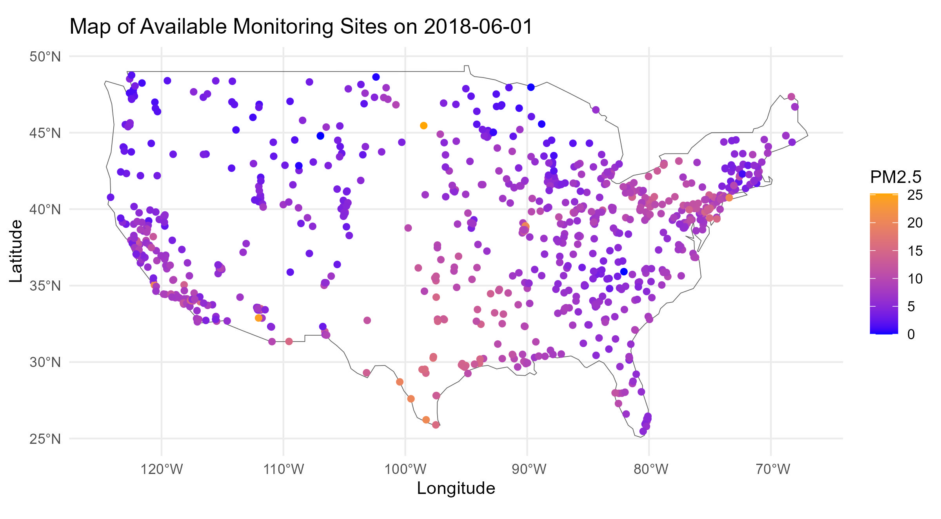
An Example Plot

Slide 6
R-INLA
The integrated nested Laplace approximation (INLA) is a method for approximate Bayesian inference.
It has established itself as an alternative to other methods such as Markov chain Monte Carlo because of its speed and ease of use via the R-INLA package.
Install instruction

Slide 7
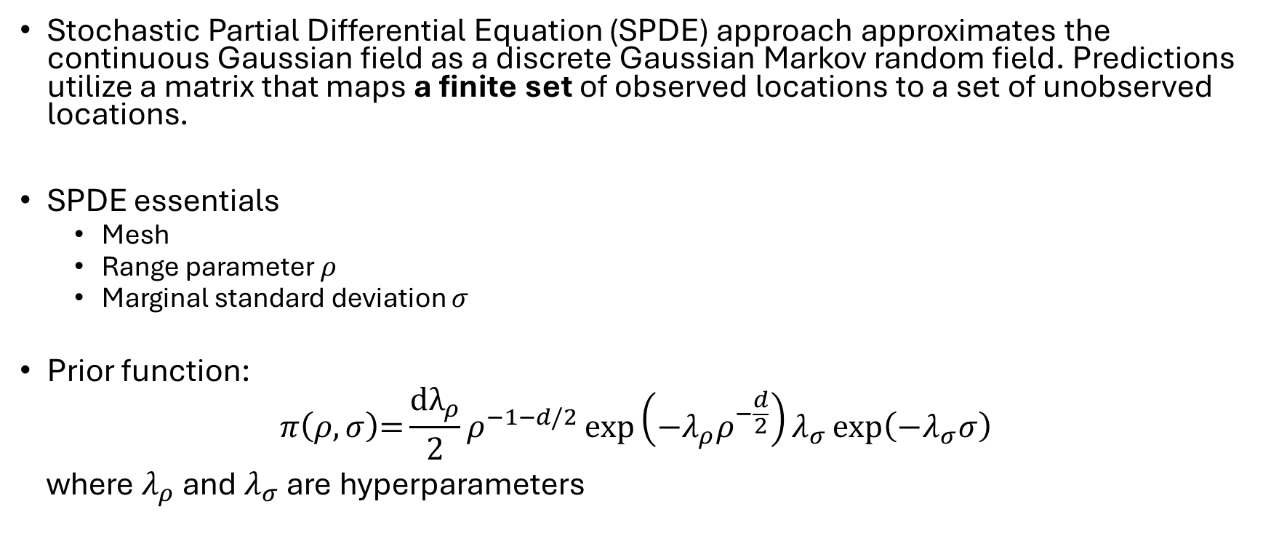
Modeling PM2.5: SPDE
Stochastic Partial Differential Equation (SPDE) approach approximates the continuous Gaussian field as a discrete Gaussian Markov random field. Predictions utilize a matrix that maps a finite set of observed locations to a set of unobserved locations.
SPDE essentials
Mesh
Range parameter 𝜌
Marginal standard deviation 𝜎
Prior function:
$$π\left(ρ,σ\right)\text{=}\frac{\text{d}λ_{ρ}}{2}ρ^{−1−d/2}\exp\left(−λ_{ρ}ρ^{−\frac{d}{2}}\right)λ_{σ}\exp\left(−λ_{σ}σ\right)$$
where $λ_{ρ}$ and $λ_{σ}$ are hyperparameters

Slide 8
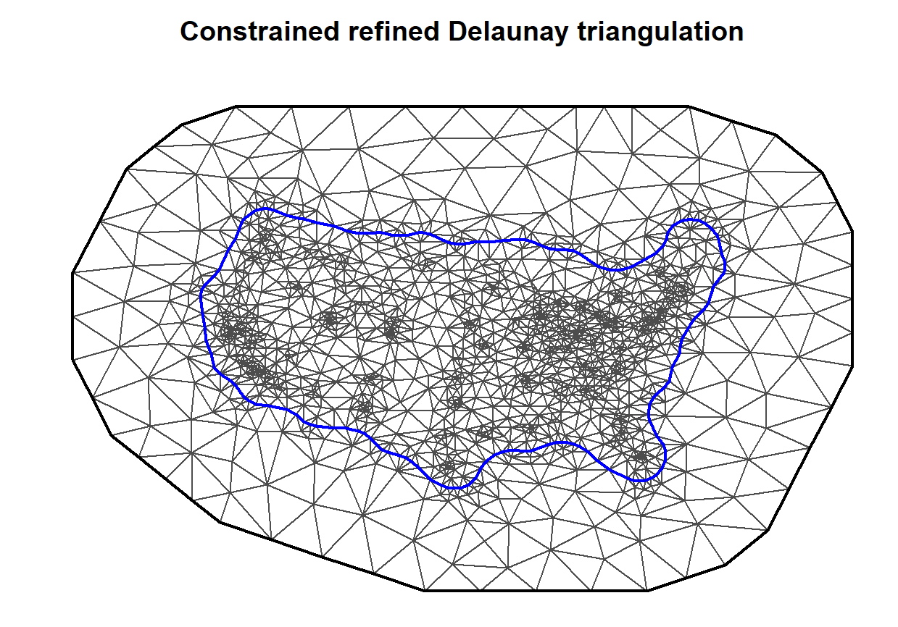
Mesh Example
Larger triangles are specified close to the boundary to alleviate boundary effect.

Slide 9
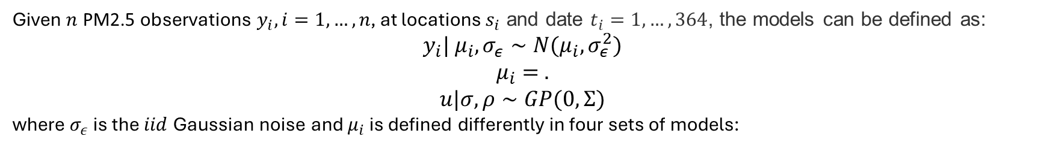
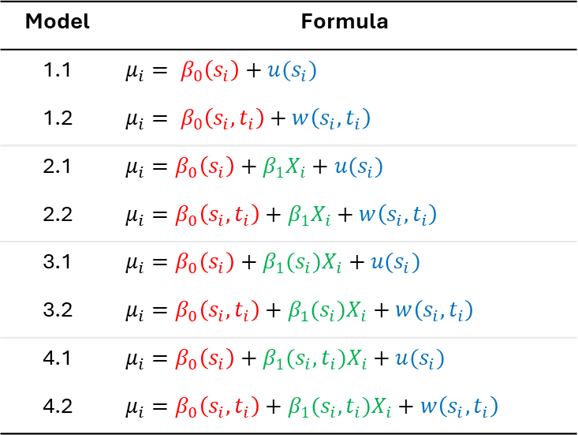
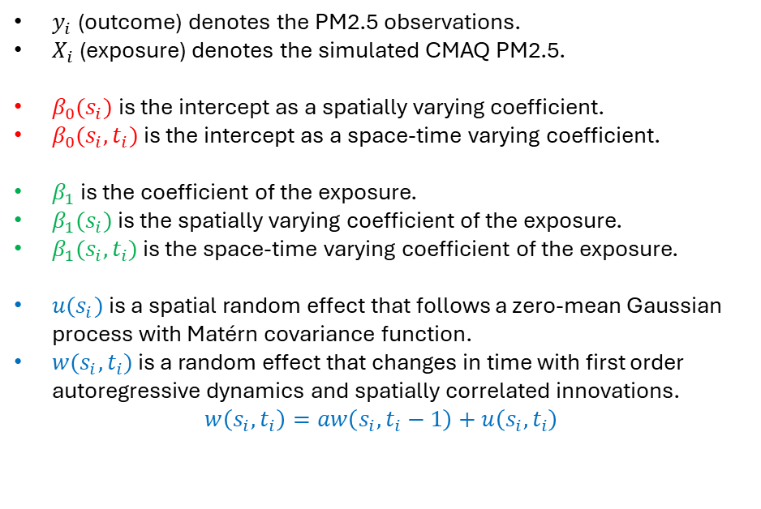
Models
Given $n$ PM2.5 observations $y_{i}, i=1, …,n$, at locations $s_{i}$ and date $t_{i}=1, …, 364$, the models can be defined as:
$$y_{i}| μ_{i}, σ_{ε}∼N(μ_{i},σ_{ε}^{2})$$
$μ_{i}= .$
$$u|σ,ρ∼GP(0, Σ)$$
where $σ_{ε}$ is the $iid$ Gaussian noise and $μ_{i}$ is defined differently in four sets of models:
Model | Formula
1.1 | $$μ_{i}= β_{0}\left(s_{i}\right)+u(s_{i})$$
1.2 | $$μ_{i}= β_{0}\left(s_{i},t_{i}\right)+w\left(s_{i}, t_{i}\right)$$
2.1 | $$μ_{i}=β_{0}\left(s_{i}\right)+β_{1}X_{i}+u(s_{i})$$
2.2 | $$μ_{i}=β_{0}\left(s_{i},t_{i}\right)+β_{1}X_{i}+w\left(s_{i}, t_{i}\right)$$
3.1 | $$μ_{i}=β_{0}\left(s_{i}\right)+β_{1}(s_{i})X_{i}+u(s_{i})$$
3.2 | $$μ_{i}=β_{0}\left(s_{i},t_{i}\right)+β_{1}(s_{i})X_{i}+w\left(s_{i}, t_{i}\right)$$
4.1 | $$μ_{i}=β_{0}\left(s_{i}\right)+β_{1}(s_{i},t_{i})X_{i}+u(s_{i})$$
4.2 | $$μ_{i}=β_{0}\left(s_{i},t_{i}\right)+β_{1}(s_{i},t_{i})X_{i}+w\left(s_{i}, t_{i}\right)$$
$y_{i}$ (outcome) denotes the PM2.5 observations.
$X_{i}$ (exposure) denotes the simulated CMAQ PM2.5.
$β_{0}(s_{i})$ is the intercept as a spatially varying coefficient.
$β_{0}(s_{i}, t_{i})$ is the intercept as a space-time varying coefficient.
$β_{1}$ is the coefficient of the exposure.
$β_{1}(s_{i})$ is the spatially varying coefficient of the exposure.
$β_{1}(s_{i},t_{i})$ is the space-time varying coefficient of the exposure.
$u(s_{i})$ is a spatial random effect that follows a zero-mean Gaussian process with Matérn covariance function.
$w(s_{i}, t_{i})$ is a random effect that changes in time with first order autoregressive dynamics and spatially correlated innovations.
$$w\left(s_{i}, t_{i}\right)=aw\left(s_{i},t_{i}−1\right)+u\left(s_{i},t_{i}\right)$$

Slide 10
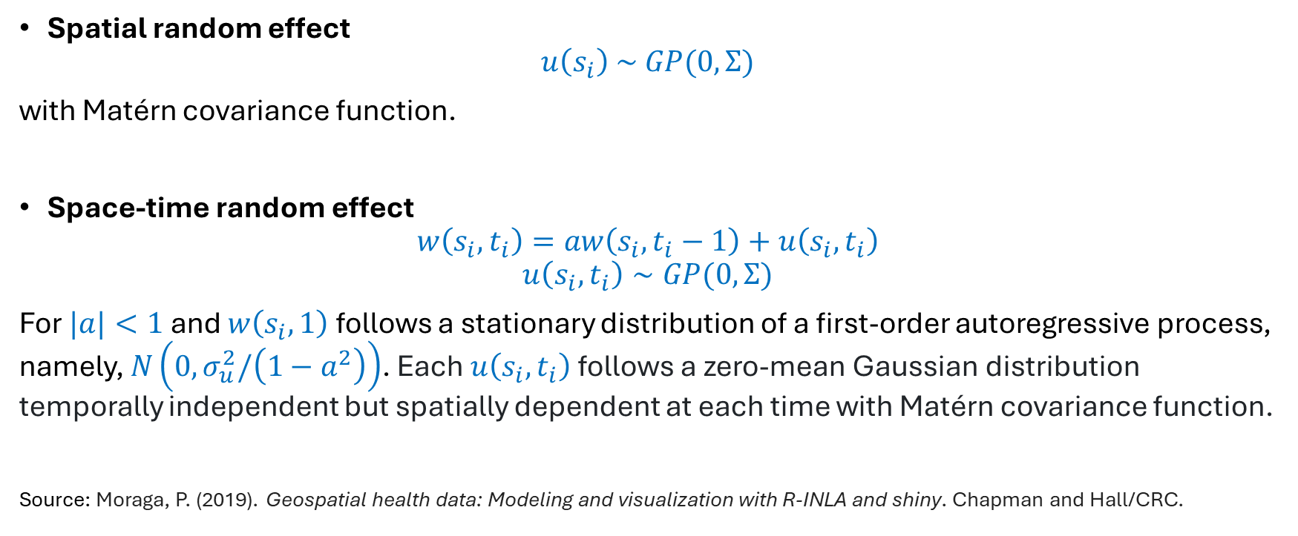
Models Continue
Spatial random effect
$$u\left(s_{i}\right) \sim GP(0, Σ)$$
with Matérn covariance function.
Space-time random effect
$$w\left(s_{i}, t_{i}\right)=aw\left(s_{i},t_{i}−1\right)+u\left(s_{i},t_{i}\right)$$
$$u\left(s_{i},t_{i}\right)∼GP(0, Σ)$$
For $|a|<1$ and $w\left(s_{i}, 1\right)$ follows a stationary distribution of a first-order autoregressive process, namely, $N\left(0,σ_{u}^{2}\text{/}\left(1−a^{2}\right)\right)$. Each $u\left(s_{i},t_{i}\right)$ follows a zero-mean Gaussian distribution temporally independent but spatially dependent at each time with Matérn covariance function.
Source: Moraga, P. (2019). Geospatial health data: Modeling and visualization with R-INLA and shiny. Chapman and Hall/CRC.

Slide 11
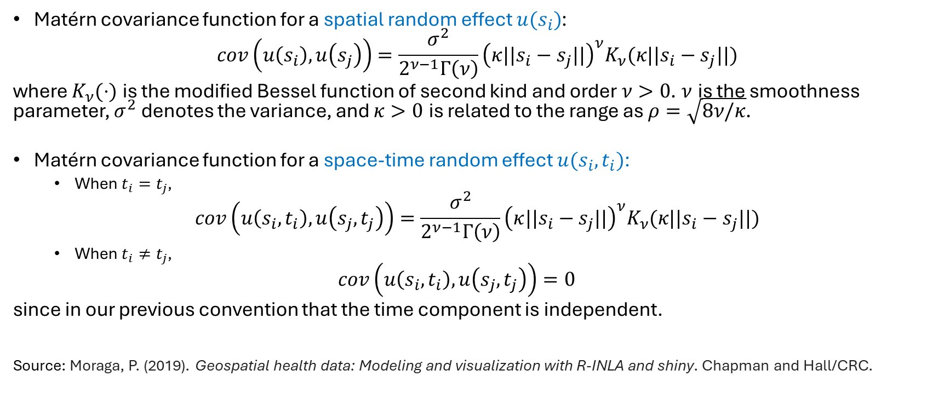
Matérn Covariance
Matérn covariance function for a spatial random effect $u(s_{i})$:
$$cov\left(u\left(s_{i}\right), u\left(s_{j}\right)\right)=\frac{σ^{2}}{2^{ν−1}Γ\left(ν\right)}{\left(κ||s_{i}−s_{j}||\right)}^{ν}K_{ν}(κ||s_{i}−s_{j}||)$$
where $K_{ν}(⋅)$ is the modified Bessel function of second kind and order $ν>0$. $ν$ is the smoothness parameter, $σ^{2}$ denotes the variance, and $κ>0$ is related to the range as $ρ=\sqrt{8ν/κ}$.
Matérn covariance function for a space-time random effect $u(s_{i}, t_{i})$:
When $t_{i}=t_{j}$,
$$cov\left(u\left(s_{i}, t_{i}\right), u\left(s_{j}, t_{j}\right)\right)=\frac{σ^{2}}{2^{ν−1}Γ\left(ν\right)}{\left(κ||s_{i}−s_{j}||\right)}^{ν}K_{ν}(κ||s_{i}−s_{j}||)$$
When $t_{i}≠t_{j}$,
$$cov\left(u\left(s_{i}, t_{i}\right), u\left(s_{j}, t_{j}\right)\right)=0$$
since in our previous convention that the time component is independent.
Source: Moraga, P. (2019). Geospatial health data: Modeling and visualization with R-INLA and shiny. Chapman and Hall/CRC.

Slide 12
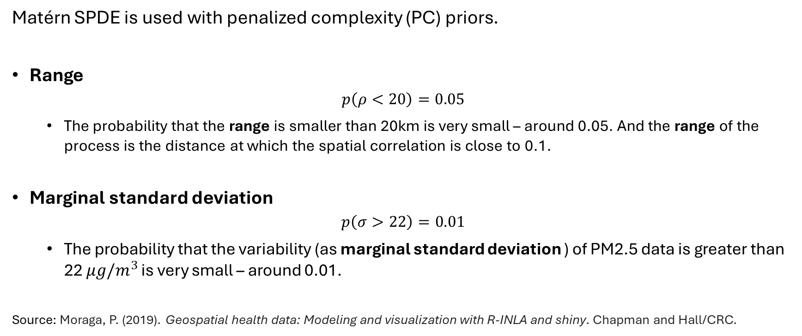
Priors
Matérn SPDE is used with penalized complexity (PC) priors.
Range
$$p\left(ρ<20\right)=0.05$$
The probability that the range is smaller than 20km is very small – around 0.05. And the range of the process is the distance at which the spatial correlation is close to 0.1.
Marginal standard deviation
$$p\left(σ>22\right)=0.01$$
The probability that the variability (as marginal standard deviation ) of PM2.5 data is greater than 22 $μg/m^{3}$ is very small – around 0.01.
Source: Moraga, P. (2019). Geospatial health data: Modeling and visualization with R-INLA and shiny. Chapman and Hall/CRC.

Slide 13
Model Selection
10-fold Spatial Cross-validation is performed to select an optimal model among the 8 models that we previously defined, based on the root mean square error (smaller is better) and the coverage (larger is better) of 95% prediction intervals.
To obtain folds, only locations are sampled, meaning that the test data are every day's PM2.5 measurements at sampled sites in the 1-week domain.
Normally train and test data in CV are independent, but we cannot assume that for spatial data.
Solution: exclude disks around test data to reduce dependence.

Slide 14
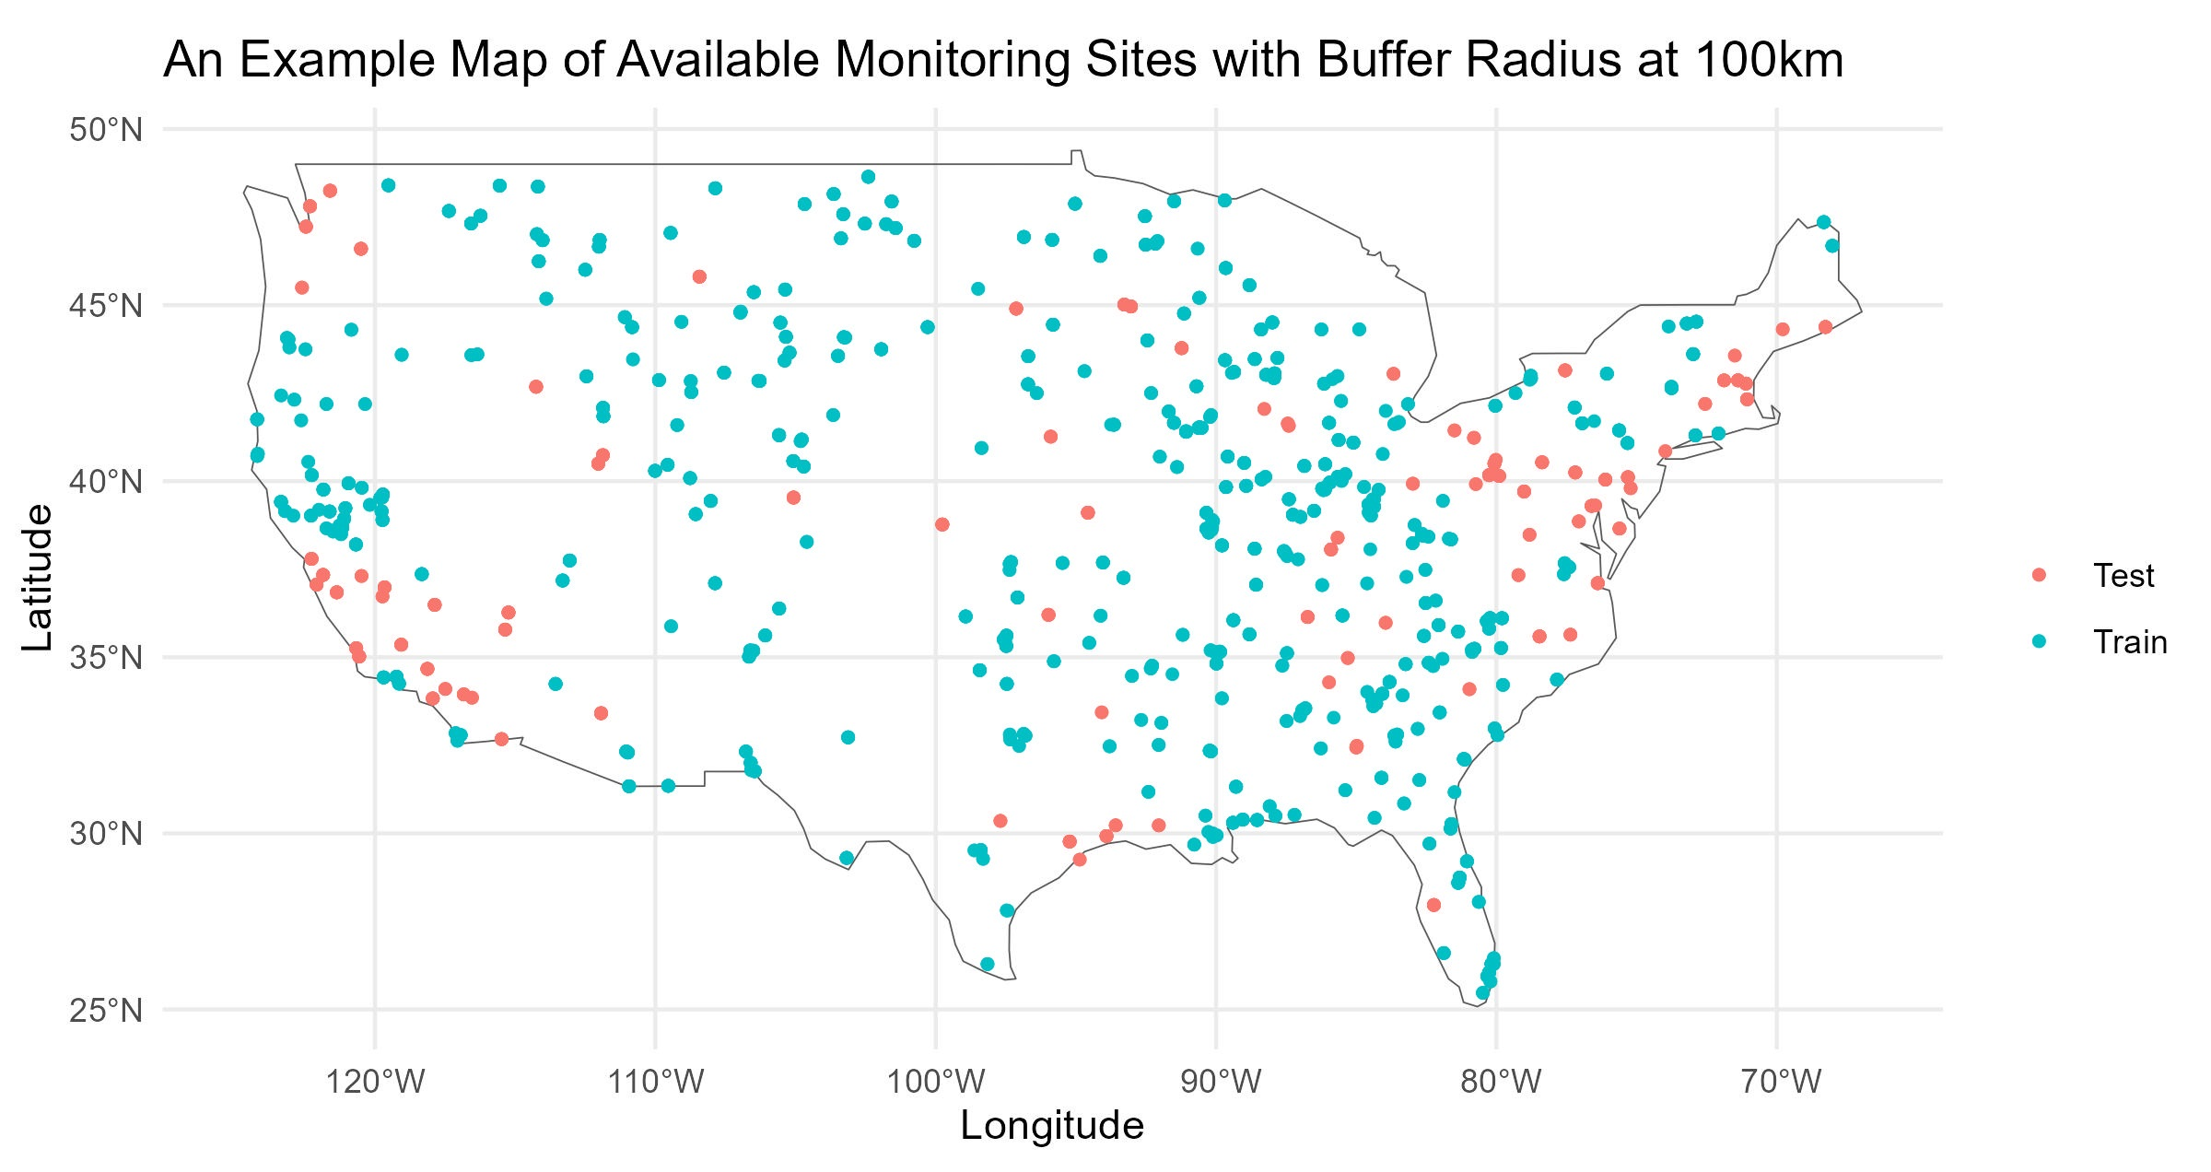
Plot of Train and Test Data

Slide 15
RMSE by Quarters
Root Mean Square Error
 | Q1 | Q2 | Q3 | Q4 | Overall
Model 1.1 | 5.96 | 4.08 | 7.68 | 9.04 | 6.97
Model 1.2 | 5.96 | 4.08 | 7.68 | 9.04 | 6.97
Model 2.1 | 5.31 | 3.59 | 6.67 | 7.92 | 6.11
Model 2.2 | 5.31 | 3.59 | 6.67 | 7.92 | 6.11
Model 3.1 | 5.79 | 4.01 | 7.24 | 8.05 | 6.48
Model 3.2 | 5.65 | 3.94 | 6.95 | 7.53 | 6.19
Model 4.1 | 5.85 | 4.04 | 7.43 | 8.49 | 6.69
Model 4.2 | 5.75 | 4 | 7.22 | 8.03 | 6.45
No buffer / radius 0km
Model 2.1 and 2.2 have the smallest RMSE
overall and in all quarters.
PM2.5 are predicted the most accurately in
Q2 (Apr - Jun) by all models.
Root Mean Square Error
 | Q1 | Q2 | Q3 | Q4 | Overall
Model 1.1 | 6.02 | 4.11 | 7.73 | 9.15 | 7.04
Model 1.2 | 6.02 | 4.11 | 7.73 | 9.15 | 7.04
Model 2.1 | 5.38 | 3.62 | 6.82 | 8.19 | 6.26
Model 2.2 | 5.38 | 3.62 | 6.82 | 8.19 | 6.26
Model 3.1 | 5.98 | 4.09 | 7.52 | 8.96 | 6.9
Model 3.2 | 5.94 | 4.06 | 7.35 | 8.79 | 6.79
Model 4.1 | 6 | 4.1 | 7.63 | 9.06 | 6.97
Model 4.2 | 5.97 | 4.08 | 7.53 | 8.97 | 6.9
Radius 100km
Root Mean Square Error
 | Q1 | Q2 | Q3 | Q4 | Overall
Model 1.1 | 6.1 | 4.16 | 7.81 | 9.27 | 7.12
Model 1.2 | 6.1 | 4.16 | 7.81 | 9.27 | 7.12
Model 2.1 | 5.46 | 3.69 | 7.08 | 8.38 | 6.42
Model 2.2 | 5.46 | 3.69 | 7.08 | 8.38 | 6.42
Model 3.1 | 6.1 | 4.16 | 7.73 | 9.25 | 7.09
Model 3.2 | 6.1 | 4.16 | 7.66 | 9.24 | 7.07
Model 4.1 | 6.1 | 4.16 | 7.78 | 9.26 | 7.11
Model 4.2 | 6.1 | 4.16 | 7.74 | 9.25 | 7.1
Radius 200km
Notes:
Add coverages

Slide 16
Coverage by Quarters
Coverage of 95% Prediction Interval
 | Q1 | Q2 | Q3 | Q4 | Overall
Model 1.1 | 0.353 | 0.427 | 0.329 | 0.333 | 0.36
Model 1.2 | 0.241 | 0.294 | 0.223 | 0.223 | 0.245
Model 2.1 | 0.451 | 0.537 | 0.425 | 0.466 | 0.469
Model 2.2 | 0.308 | 0.376 | 0.29 | 0.328 | 0.325
Model 3.1 | 0.367 | 0.437 | 0.343 | 0.35 | 0.374
Model 3.2 | 0.256 | 0.306 | 0.239 | 0.245 | 0.261
Model 4.1 | 0.361 | 0.434 | 0.338 | 0.342 | 0.368
Model 4.2 | 0.25 | 0.301 | 0.234 | 0.236 | 0.255
No buffer / radius 0km
Model 2.1 has the largest coverage probability
overall and in all quarters.
PM2.5 are predicted the most accurately in Q2
(Apr - Jun) by all models.
Coverage of 95% Prediction Interval
 | Q1 | Q2 | Q3 | Q4 | Overall
Model 1.1 | 0.367 | 0.443 | 0.342 | 0.361 | 0.378
Model 1.2 | 0.252 | 0.306 | 0.233 | 0.245 | 0.259
Model 2.1 | 0.449 | 0.54 | 0.417 | 0.475 | 0.47
Model 2.2 | 0.304 | 0.379 | 0.289 | 0.331 | 0.326
Model 3.1 | 0.373 | 0.445 | 0.348 | 0.368 | 0.383
Model 3.2 | 0.258 | 0.311 | 0.241 | 0.253 | 0.266
Model 4.1 | 0.37 | 0.444 | 0.345 | 0.364 | 0.381
Model 4.2 | 0.255 | 0.308 | 0.238 | 0.249 | 0.262
Radius 100km
Coverage of 95% Prediction Interval
 | Q1 | Q2 | Q3 | Q4 | Overall
Model 1.1 | 0.373 | 0.446 | 0.348 | 0.385 | 0.388
Model 1.2 | 0.255 | 0.31 | 0.238 | 0.265 | 0.267
Model 2.1 | 0.445 | 0.529 | 0.414 | 0.487 | 0.469
Model 2.2 | 0.304 | 0.373 | 0.286 | 0.343 | 0.326
Model 3.1 | 0.375 | 0.447 | 0.351 | 0.388 | 0.39
Model 3.2 | 0.259 | 0.312 | 0.242 | 0.267 | 0.27
Model 4.1 | 0.374 | 0.446 | 0.349 | 0.386 | 0.389
Model 4.2 | 0.257 | 0.311 | 0.24 | 0.266 | 0.268
Radius 200km

Slide 17
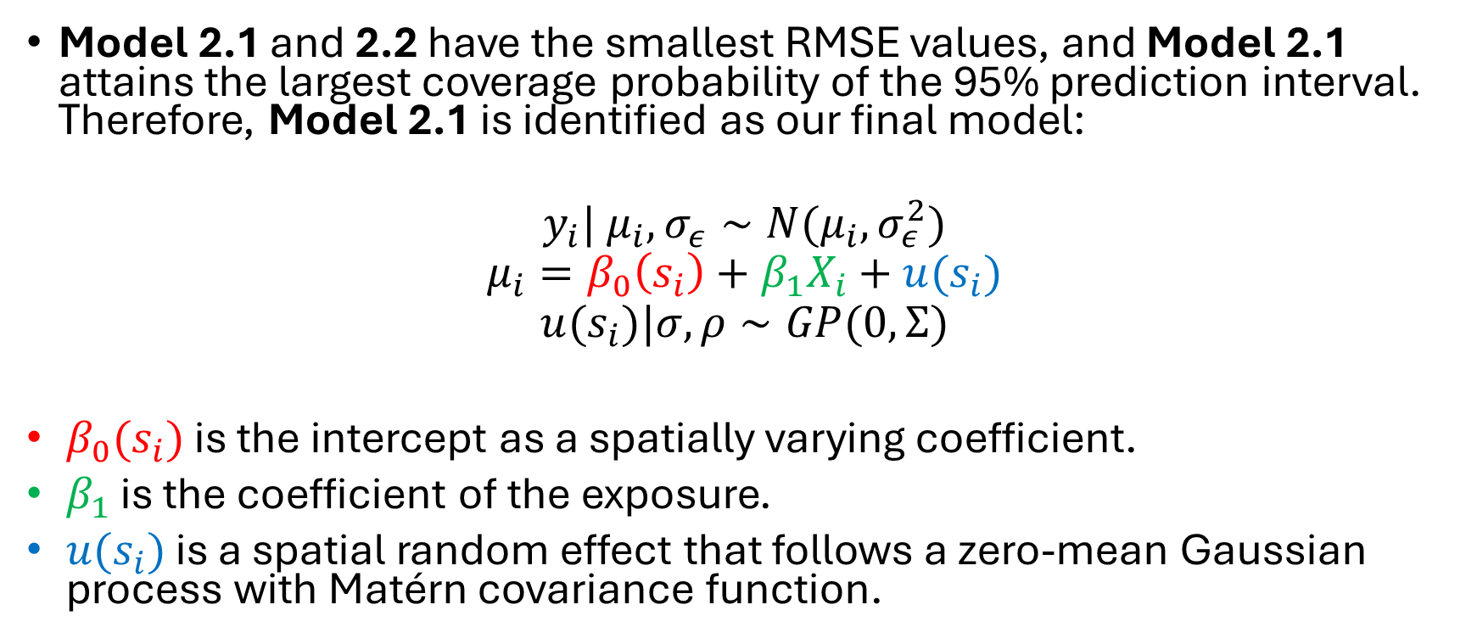
Conclusion
Model 2.1 and 2.2 have the smallest RMSE values, and Model 2.1 attains the largest coverage probability of the 95% prediction interval. Therefore, Model 2.1 is identified as our final model:
$$y_{i}| μ_{i}, σ_{ε}∼N(μ_{i},σ_{ε}^{2})$$
$$μ_{i}=β_{0}\left(s_{i}\right)+β_{1}X_{i}+u(s_{i})$$
$$u(s_{i})|σ,ρ∼GP(0, Σ)$$
$β_{0}(s_{i})$ is the intercept as a spatially varying coefficient.
$β_{1}$ is the coefficient of the exposure.
$u(s_{i})$ is a spatial random effect that follows a zero-mean Gaussian process with Matérn covariance function.

Slide 18
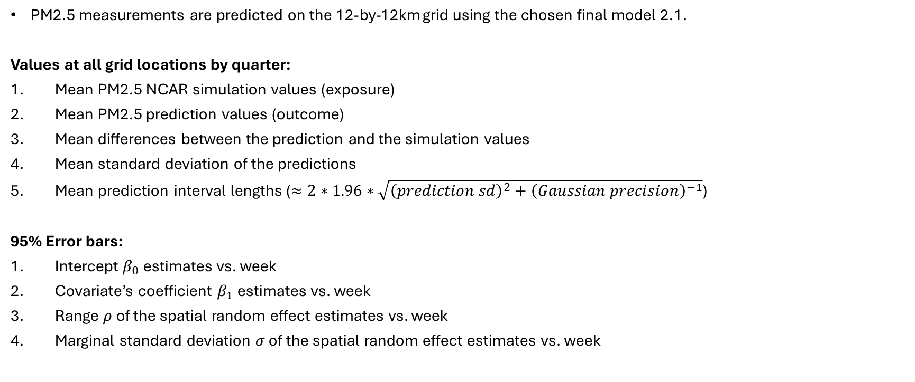
Model 2.1 Plots
PM2.5 measurements are predicted on the 12-by-12km grid using the chosen final model 2.1.
Values at all grid locations by quarter:
Mean PM2.5 NCAR simulation values (exposure)
Mean PM2.5 prediction values (outcome)
Mean differences between the prediction and the simulation values
Mean standard deviation of the predictions
Mean prediction interval lengths ($≈2∗1.96∗\sqrt{{\left(prediction sd\right)}^{2}+{\left(Gaussian precision\right)}^{−1}}$)
95% Error bars:
Intercept $β_{0}$ estimates vs. week
Covariate’s coefficient $β_{1}$ estimates vs. week
Range $ρ$of the spatial random effect estimates vs. week
Marginal standard deviation $σ$ of the spatial random effect estimates vs. week

Slide 19
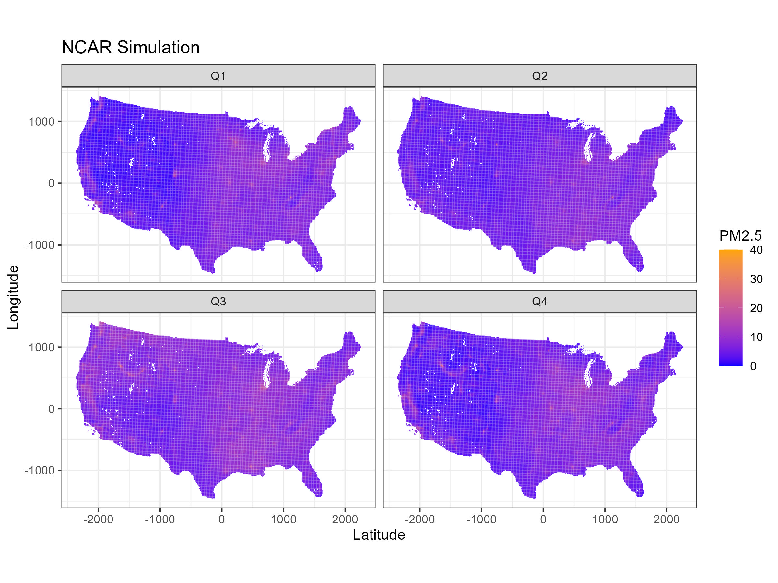

Slide 20
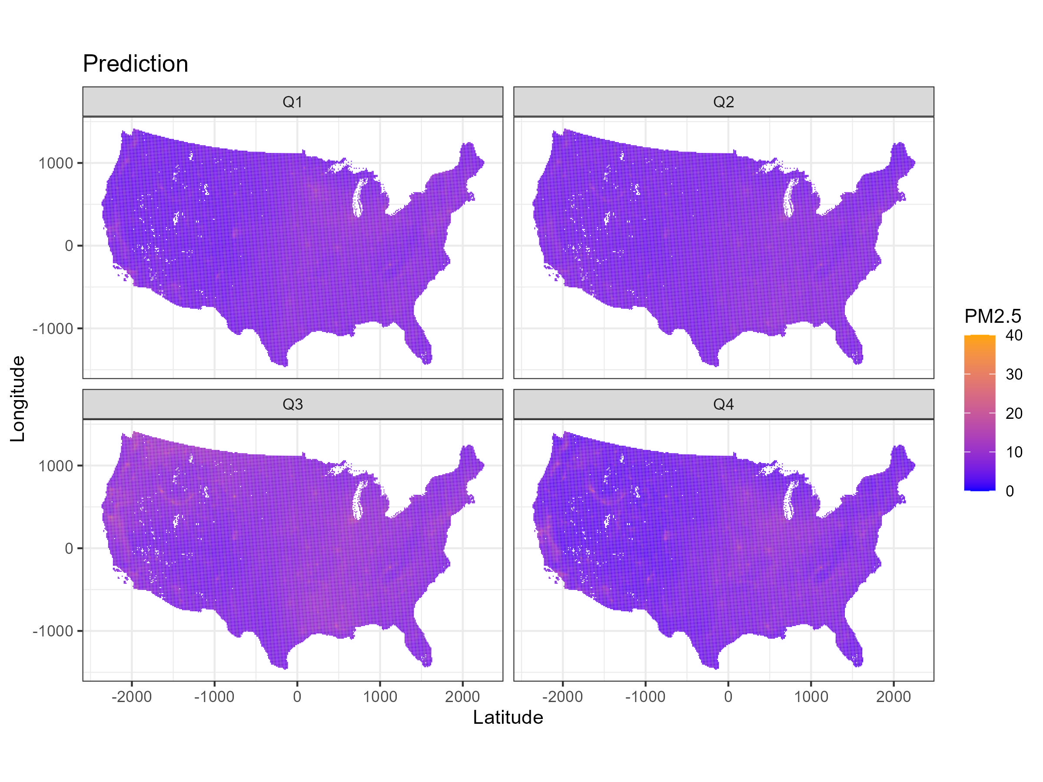

Slide 21
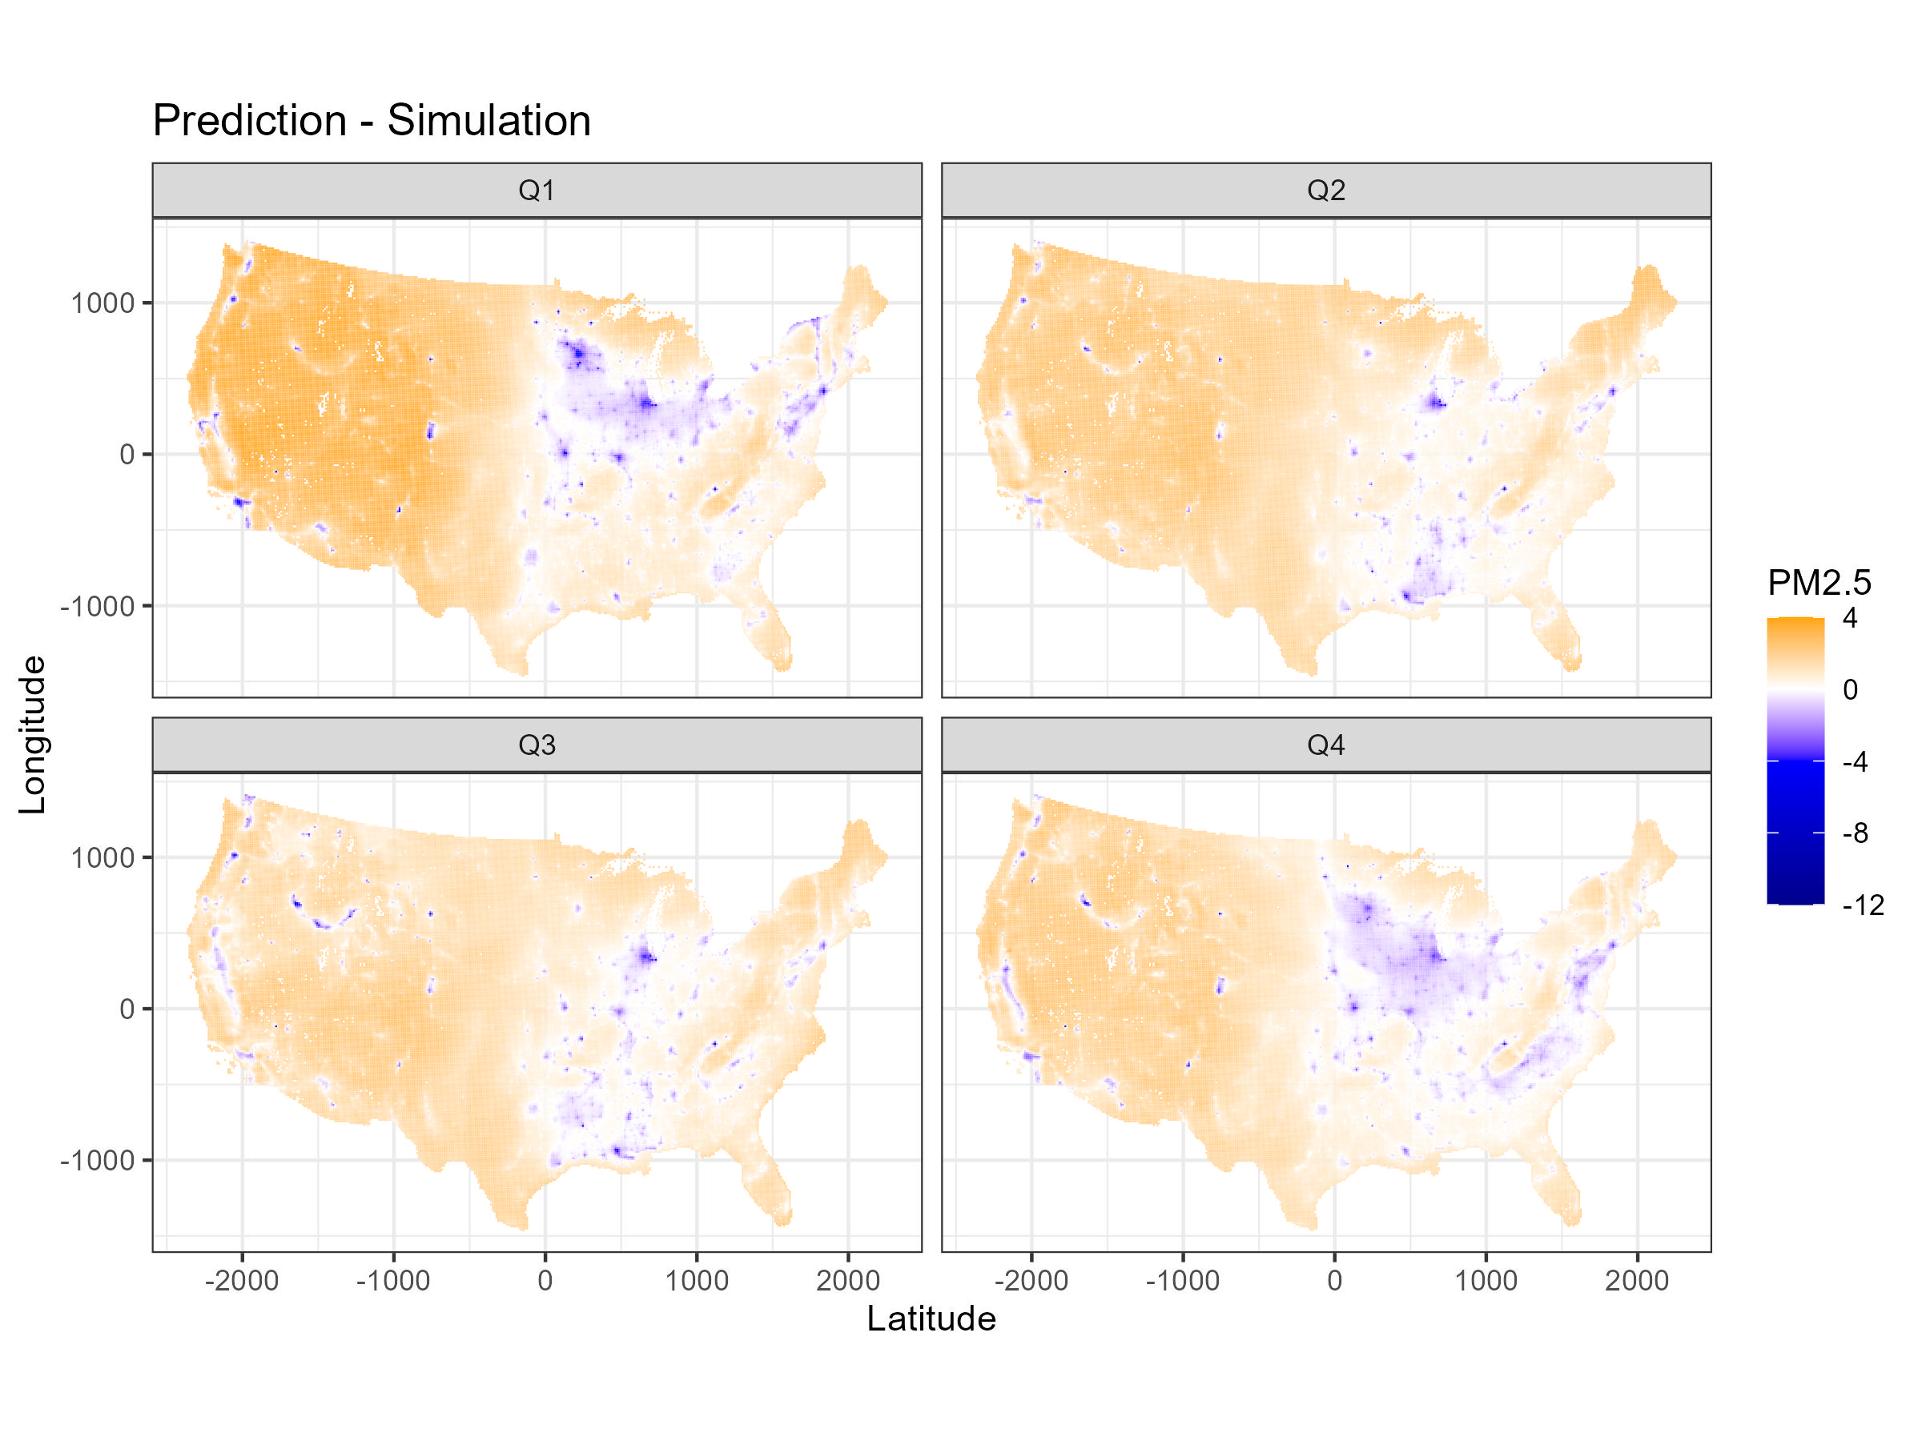
Note. PM2.5 are mean values by quarter.

Slide 22
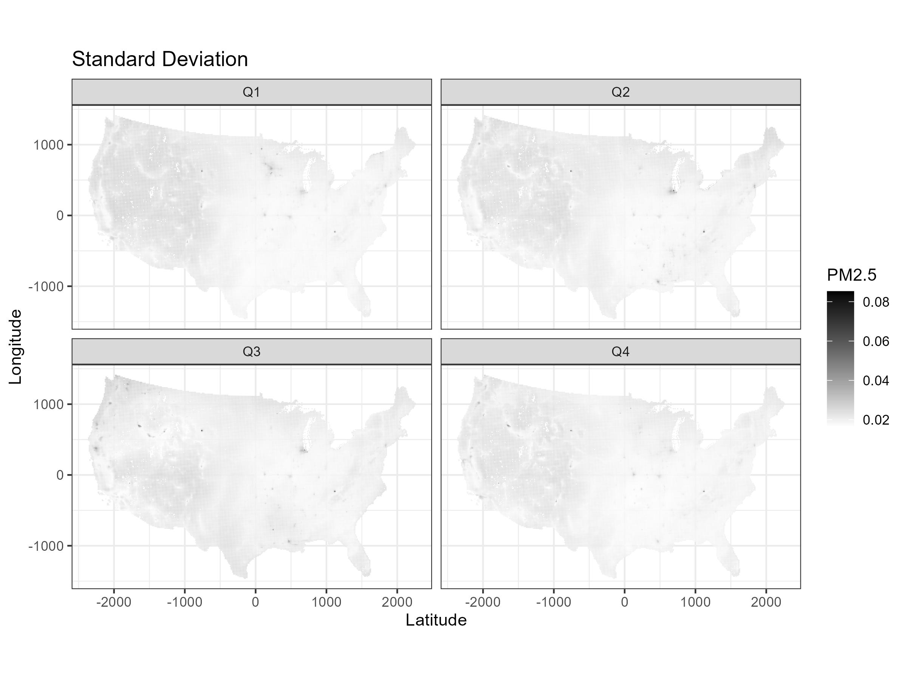

Slide 23
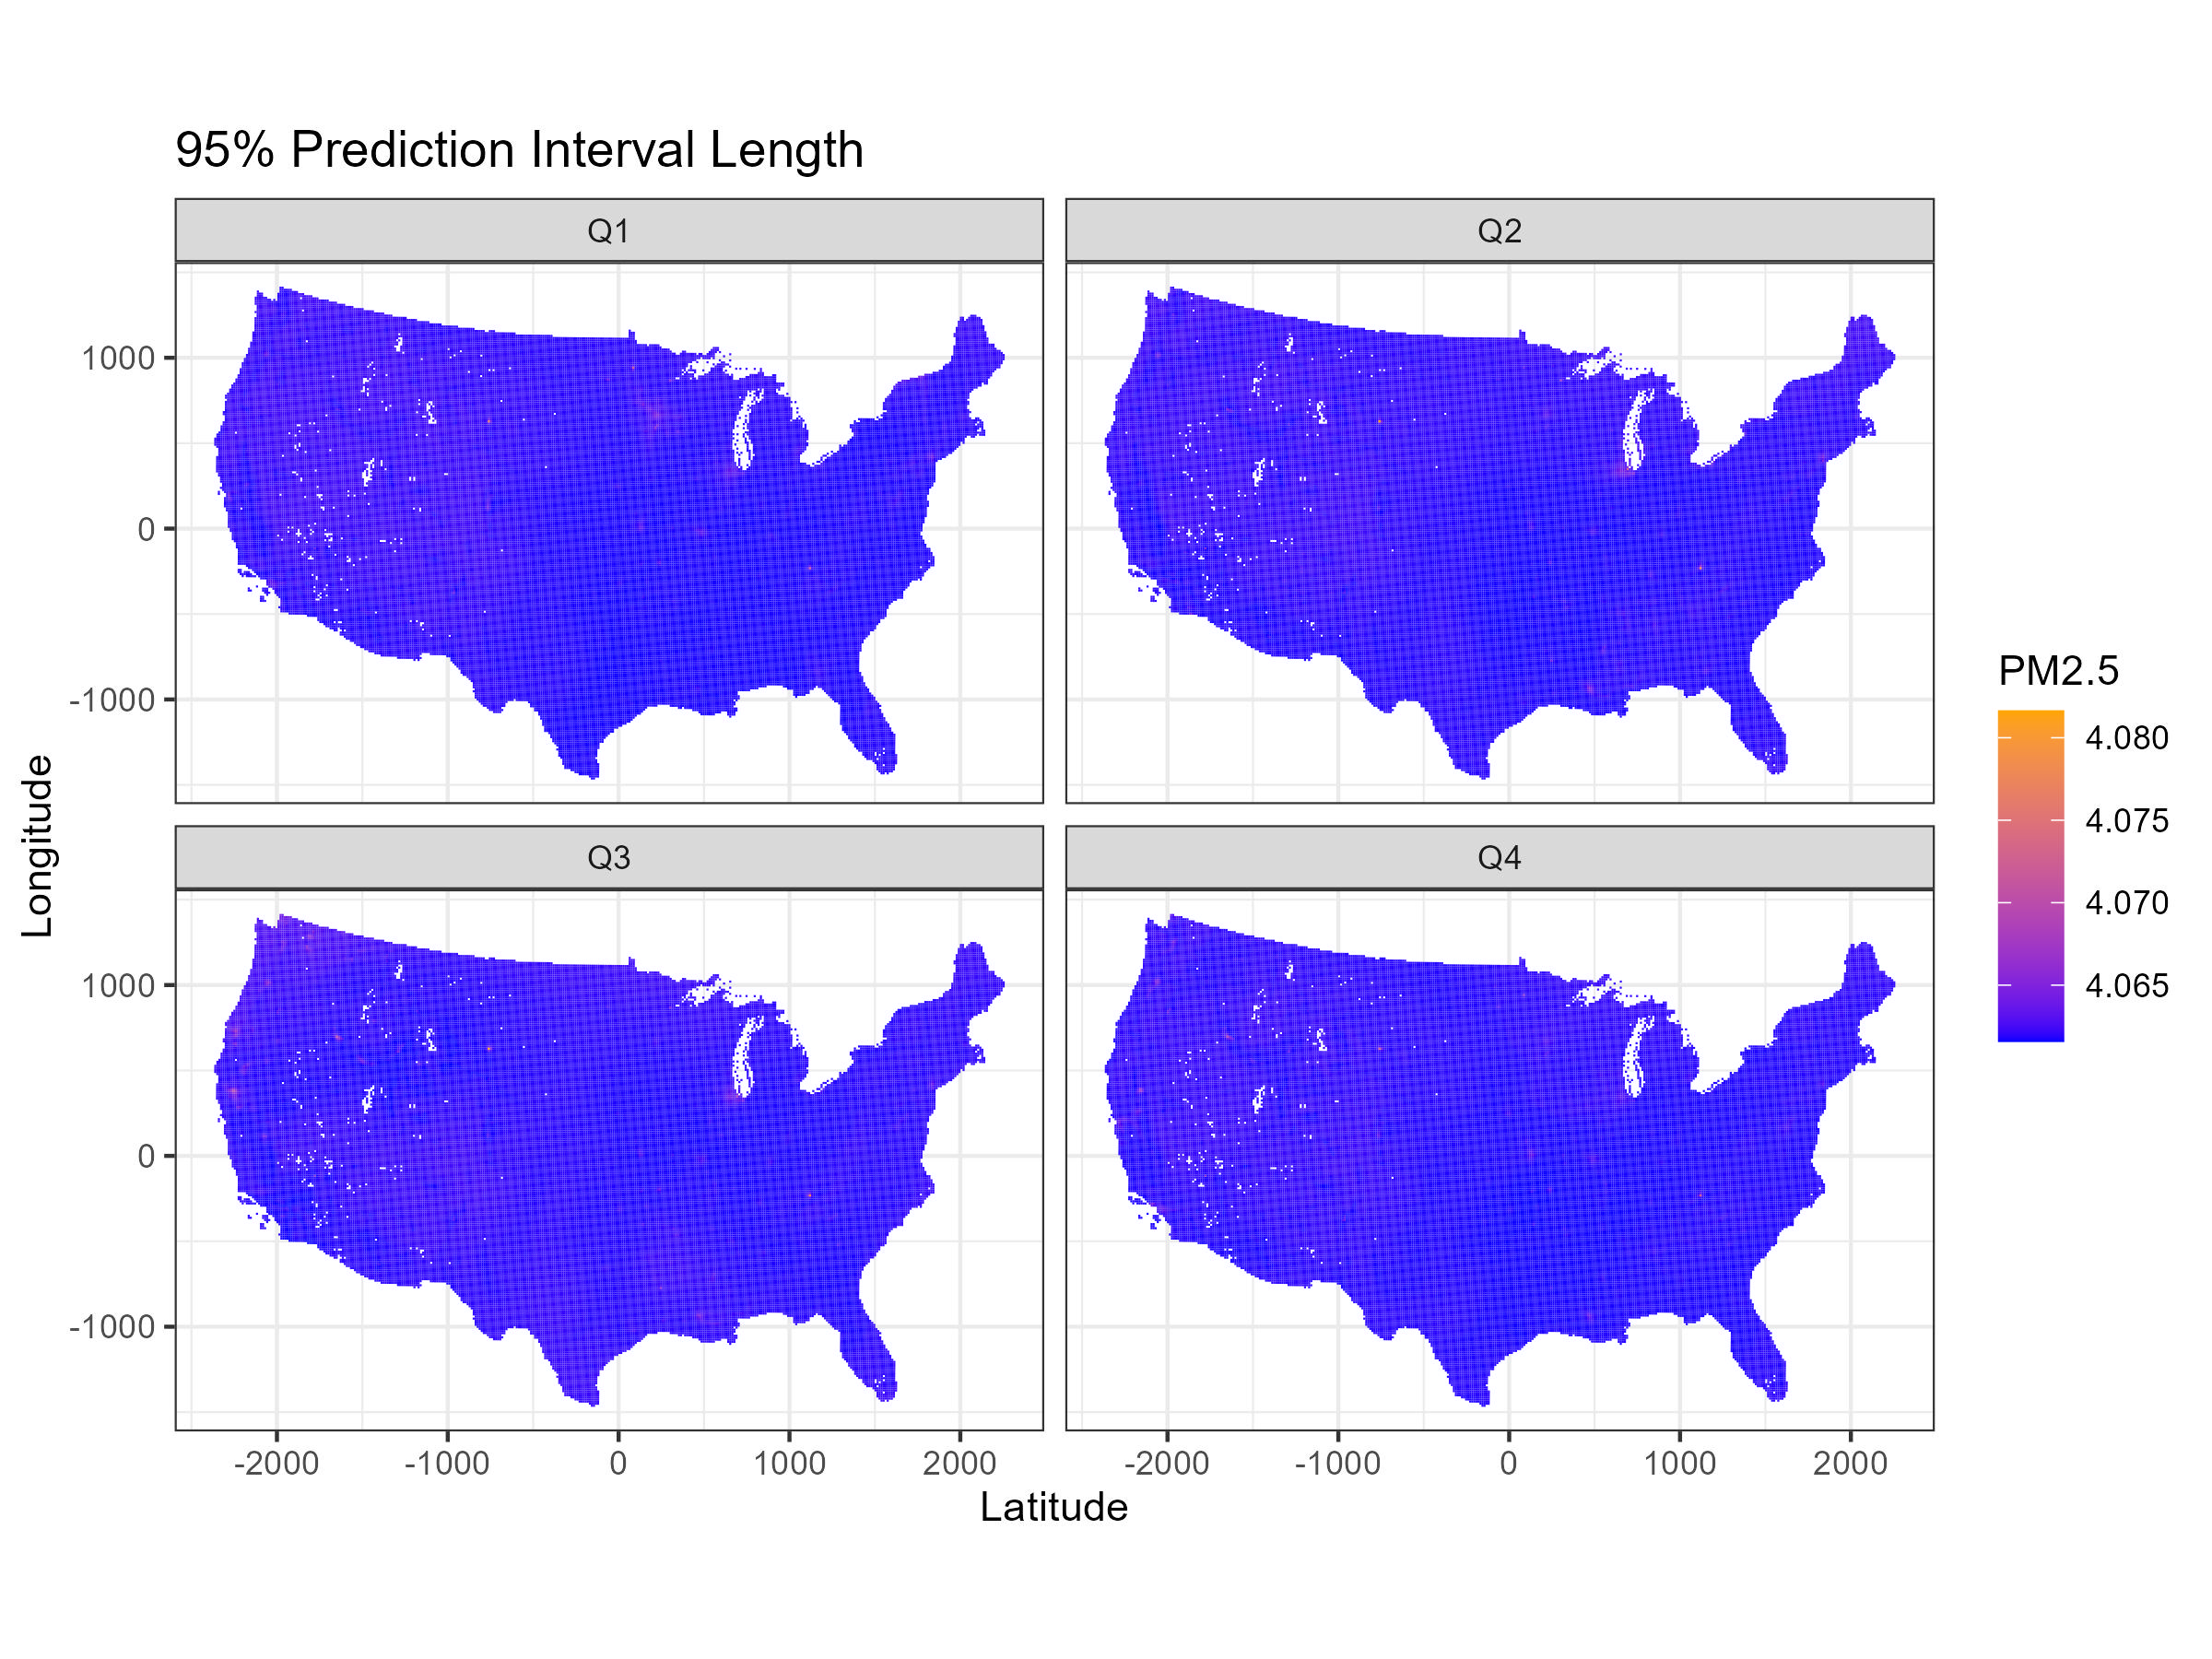

Slide 24
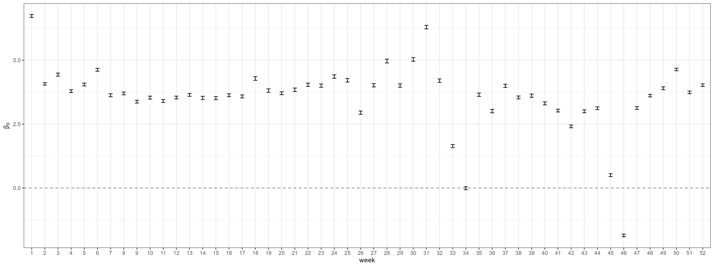

Intercept $β_{0}$ estimates vs. week

Slide 25
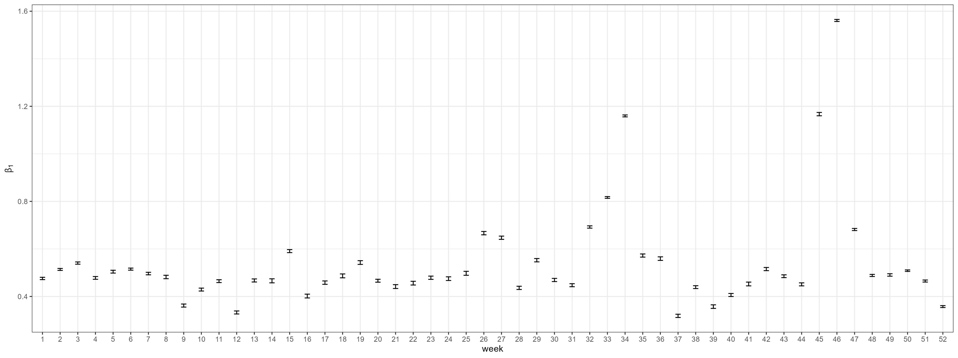

Covariate’s coefficient $β_{1}$ estimates vs. week

Slide 26
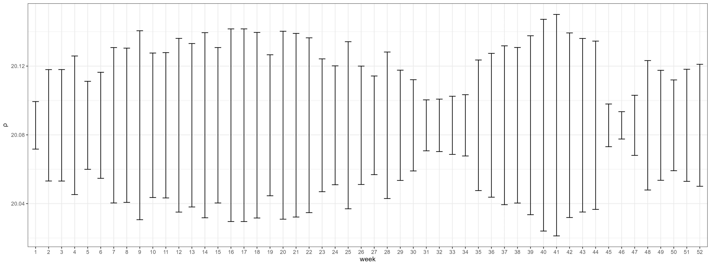
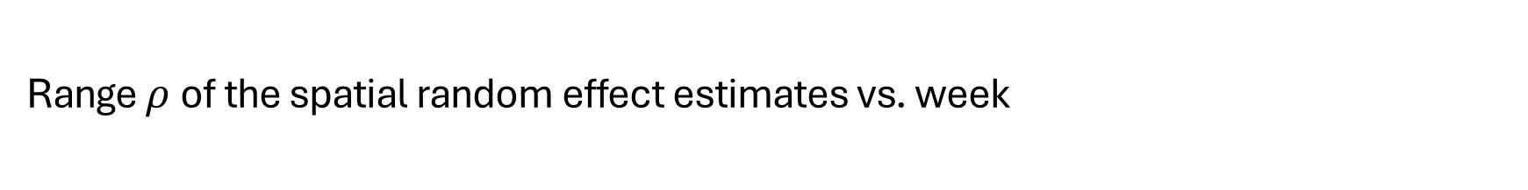
Range $ρ$of the spatial random effect estimates vs. week

Slide 27
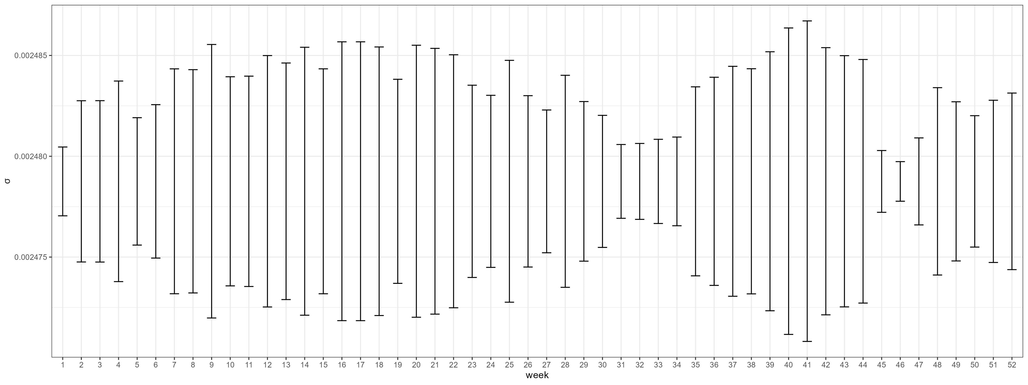

Marginal standard deviation $σ$ of the spatial random effect estimates vs. week

Slide 28
Appendix: scripts
 | Objective | Sampling Method | Buffer Radius | Data Source
script1 | Perform 10-fold CV | (Location, Day) | 100km | Specify 7 consecutive days
script2 | Perform 10-fold CV | (Location, Day) | 100km | Divide 365 days into 13*4 7-day windows
script3 | Create summary tables | - | - | Import outputs of script 2, 4, 5, 6
script4 | Perform 10-fold CV | (Location) | 100km | Divide 365 days into 13*4 7-day windows
script5 | Perform 10-fold CV | (Location) | 0km | Divide 365 days into 13*4 7-day windows
script6 | Perform 10-fold CV | (Location) | 200km | Divide 365 days into 13*4 7-day windows

Slide 29
Appendix: notes
Need to binary install INLA for HPC cluster
Library caret used to create folds does not work in cluster R sessions
soln: manually create folds using for loops
Coding error in defining buffers gets fixed
INLA crashes at some iterations (10th for script 1, many more for script 2) with errors reported as "fails to get good initial values"
soln: using pcmatern for SPDE, adding initial values for hyperparameters using script 1 results
Numerical issue: In script 2 inla.mesh.2d() takes forever to run in some job
problem caused by specifying boundary layer using max.edge = c(300, 600)
soln: round loc argument to 5 digits
soln: tune max.edge, offset arguments in inla.mesh.2d(); define and specify boundary using all monitor locations

